Slide 1
The Co-Occurring Disorder Conundrum
A Non-Clinical Way to Make an Impact
Jason Conrad & Sam Light
Franklin County Adult Probation

Slide 2
Who we are
Jason Conrad
Jason is a Chemical Dependency Probation Officer with Franklin County Court of Common Pleas. He is also a felony probation officer for Franklin County Municipal Court’s CATCH program, a specialized docket for survivors of human trafficking. He is a faculty member for the Supreme Court of Ohio’s PO training program and teaches their Cognitive-Behavioral Interventions course.
Sam Light
Sam is currently the Mental Health Supervisor at the Franklin County Adult Probation Department and oversees Crisis Intervention Training for Probation Officers. She has10 years of experience in Probation, including time spent as a Treatment Court Officer and Chemical Dependency Officer. Sam also regularly facilitates evidence-based training for her department.

Slide 3
Learning objectives
Develop an understanding of the intersection of substance use and mental health in a community correction setting.
Show confidence and self-efficacy when using interventions with offenders that have co-occurring disorders.
Debunk the myth that offenders with co-occurring disorders can’t use evidence-based tools.
Identify how to connect community supervision to treatment.
Recognize opportunities to address responsivity in case plans.

Slide 4
Co-occurring disorders is a term used when someone has both a mental health and a substance use disorder.
“Dual Diagnosis” and “Comorbidity” are other commonly used terms.
Can also refer to mental health disorders and intellectual disabilities.
There may be multiple diagnoses of each type of disorder at play, as they may meet criteria for several disorders.
Example – an individual is diagnosed with both Bipolar Disorder and Opiate Use Disorder.

Slide 5
what do we mean by “conundrum” ?

Slide 6
WHAT’S THE CONUNDRUM?
Co-occurring disorders, and their treatment, are complex – and require special attention.
Interactions between the mental illness and the SUD can make both conditions worse.
One may be more severe than the other. Is there one that’s causing more problems?
Adding criminal justice involvement creates complications.
Mental health symptoms can impact someone's adjustment to community supervision.

Slide 7
How many people have a mental illness?

Slide 8
The Statistics
1 in 4 – 5 (22.8%) adults in the U.S. have a mental illness.
Sources:
NAMI, 2021 / 2024
SAMHSA, 2024

Slide 9
How many people have a substance disorder?
Notes:
Jason
48.5 million people / 17.1% of individuals 12 years and older (SAMHSA, 2024).

Slide 10
The Statistics
1 in 4 - 5 adults in the U.S. have a mental illness.
48.5 million people / 17.1% of the U.S. population met the DSM-V criteria for an SUD. (SAMHSA)
Sources:
NAMI, 2021 / 2024
SAMHSA, 2024

Slide 11
How many people have a co-occurring disorder?

Slide 12
The Statistics
1 in 4 - 5 adults in the U.S. have a mental illness.
48.5 million people / 17.1% of the U.S. population met the DSM-V criteria for an SUD. (SAMHSA)
19.4 million adults / 7.6% in the U.S. have a co-occurring disorder.
Sources:
NAMI, 2021 / 2024
SAMHSA, 2024

Slide 13
The Statistics
1 in 4 – 5 (22.8%) adults in the U.S. have a mental illness.
48.5 million people / 17.1% of the U.S. population met the DSM-V criteria for an SUD. (SAMHSA)
19.4 million adults / 7.6% in the U.S. have a co-occurring disorder.
Among adults 18+ in 2021, those with mental illnesses in the past year were more likely than those with no mental illness to be users of illicit drugs overall (50.2% vs. 17.7%).
Sources:
NAMI, 2021 / 2024
SAMHSA, 2024

Slide 14
How does criminal justice intersect with co-occurring disorders?

Slide 15
Justice-involved individuals
Individuals with a co-occurring disorder are 12 times more likely to be arrested.
1 in 9 adults with a co-occurring disorder were arrested annually.
Most commonly for property offenses (17 %) and violent offenses (10 %).

Slide 16
Justice-involved individuals – special populations
Women with co-occurring disorders were arrested 19 times more often than women with neither a SUD or mental illness (1 in 5).
Black adults with co-occurring disorders were arrested 1.5 times more often than their white counterparts.
There are other disparities amongst marginalized populations.

Slide 17
Are people with co-occurring disorders violent?

Slide 18
Please download and install the Slido app on all computers you use
Are people with co-occurring disorders violent?
ⓘ Start presenting to display the poll results on this slide.

Slide 19
Why might individuals with co-occurring disorders be at high risk of arrest?

Slide 20
Please download and install the Slido app on all computers you use
Why might individuals with co-occurring disorders be at high risk of arrest?
ⓘ Start presenting to display the poll results on this slide.

Slide 21
WHAT ARE SOME BARRIERS TO TREATMENT?

Slide 22
Please download and install the Slido app on all computers you use
What are some barriers to seeking treatment (both AOD and MH)?
ⓘ Start presenting to display the poll results on this slide.

Slide 23
BARRIERS TO TREATMENT – mental health

Slide 24
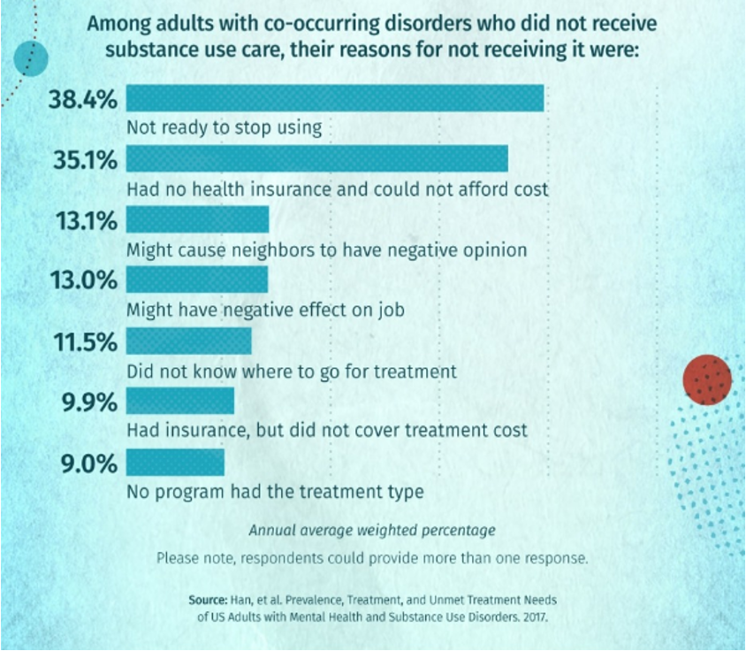
BARRIERS TO TREATMENT – substance use

Slide 25
WHAT ARE SOME CHALLENGES RELATED TO CO-OCCURRING DISORDERS? (GENERAL OR CRIMINAL JUSTICE-BASED)

Slide 26
CHALLENGES
Medication compliance.
Discovering what works and what does not.
Technical violations.
Battling symptoms while maintaining treatment motivation.
Coordination of care between agencies.
Rate of relapse.

Slide 27
What’s the difference between “therapy” and being “therapeutic” ?

Slide 28
Therapy
Provided by trained, licensed professionals who specialize in treatment of disorders.
A highly structured, often long-term process using different treatment modalities.
Many different treatment modalities –
CBT, DBT, EMDR, IDDT, etc.
Can extend beyond the risk, needs, and responsivity factors that are used in a criminal justice setting.
Often involves cost, billing, or insurance.

Slide 29
Therapeutic
Can be utilized by any type of correctional professional.
Structured, but brief interactions.
Follows cognitive-behavioral therapy principles.
Based around someone’s risk, needs, and responsivity.
Can be helpful with getting someone to a place where they’re ready for therapy / treatment.
Linking someone with therapy can be a therapeutic technique.

Slide 30
Therapy or therapeutic?
therapy
therapeutic
Provided by trained, licensed professionals who specialize in treatment of disorders.
A highly structured, often long-term process using different treatment modalities.
Many different treatment modalities – CBT, DBT, EMDR, IDDT, etc.
Can extend beyond the risk, needs, and responsivity factors that are used in a criminal justice setting.
Often involves cost, billing, or insurance.
Can be utilized by any type of correctional professional.
Structured, but brief interactions.
Follows cognitive-behavioral therapy principles.
Based around someone’s risk, needs, and responsivity.
Can be helpful with getting someone to a place where they’re ready for therapy / treatment.
Linking someone with therapy can be a therapeutic technique.

Slide 31
How do we decide how to be therapeutic ?
What are we even looking to target ?
How do we target that?
How can that targeting be therapeutic?

Slide 32
RNR basics
RISK
NEED
RESPONSIVITY
The likelihood, or risk, that someone will re-offend. (Low, Moderate, High, Very High)
Areas that should be targeted to reduce the risk of re-offending.
Factors that influence someone’s receptiveness to interventions.

Slide 33
RISK FACTORS
Criminal History
Antisocial Attitudes
Antisocial Personality
Peer Associations
Family and Social Support
Education and Employment
Substance Use
Leisure Time
Neighborhood
Per the ORAS, developed by the University of Cincinnati.

Slide 34
Where do co-occurring disorders fall?
Substance Use is a criminogenic need – i.e., it is an identified risk factor for reoffending.
Mental Health is a responsivity factor – it is not a direct risk factor. Rather, it impacts how we address other criminogenic needs.
Trailer Tools – TCU-DS
Trailer Tools – CMHS

Slide 35
a conundrum
Therein lies the complication – Co-occurring disorders means heavy focus on both Need AND Responsivity.
How can we target substance use if someone is actively manic?
How can we target employment if someone is actively psychotic?

Slide 36
CASE PLANNING
ASSESS – Risk assessments identify risk of re-offending.
IDENTIFY – Decide which identified risk factors are most important.
PLAN – Create and implement a case plan based on the assessment and risk factors.
INTERVENE – Engage in evidence-based interventions to address and reduce risk.
REVIEW – Periodically review the assessment, any changes, and progress.
IDENTIFY – Are there responsivity factors involved?

Slide 37
EVIDENCE-BASED PRACTICES
COST-BENEFIT ANALYSIS
COGNITIVE RESTRUCTURING
SOCIAL SKILLS
PROBLEM SOLVING
MOTIVATIONAL INTERVIEWING

Slide 38
TREATMENT
A high risk / high needs population calls for robust, holistic treatment strategies.
Psychotherapy – i.e., CBT / counseling, groups, etc.
Detox – may be needed before any meaningful progress can be made on either substance use or mental health.
Medication / MAT – this includes psychiatric medications and / or MAT (such as Suboxone, Methadone, Vivitrol), which can stabilize conditions and lead to better treatment outcomes.
IDDT is an Evidence-Based Practice shown to be a highly effective treatment method – it focuses simultaneous attention on both disorders.
Case Management – can provide therapeutic and supportive services.
Supportive housing, support groups, and other supplemental services, while not technically “treatment” – can be incredibly helpful for recovery.

Slide 40
collaboration
Involving others and working as a team can be one of the best non-clinical ways to make an impact.
Treatment team meetings.
Building rapport and familiarity with external stakeholders.
Communication with relevant parties.
Clients with co-occurring disorders may be great candidates for specialty dockets.

Slide 41
EBP or emergency?
There is benefit to helping your clients explore negative, risky thought patterns and behaviors. But sometimes, some of those behaviors exceed the scope of our abilities.
If you aren’t a trained clinician, it’s often better to leave it to the professionals.
911 / 988
When is it time to call the professionals?
Audience Question – When should 911 intervene?

Slide 42
Things to consider
Is this an opportunity to address risky thinking?
Is it appropriate to do an intervention? Which tool do I use?
Is listening the best intervention?
Rapport is one of the strongest tools at your disposal.
The severity of the situation – do they have a plan and / or means?
Their history.
Are other people at risk of harm?
Where are they at in their recovery?
ARE THEY USING SUBSTANCES?
What should we keep in mind when deciding if an EBP tool is appropriate vs. deciding if law enforcement and / or mental health crisis intervention is best?

Slide 43
EBP or emergency?
You have a client – who you know has a history of suicide attempts – tell you that they’ve been depressed, and they’re worried they’ll relapse.
You have a client who says they’re having suicidal thoughts, but no plans to complete it.
You have a client who tells you they’re having suicidal thoughts, and that they have means (medications they can overdose on) and a plan.

Slide 44
EBP or emergency?
You have a client who tells you they used meth earlier today. They also tell you that they haven’t taken their medications for 2 weeks.
You have a client who is explicitly expressing that they are having homicidal thoughts.
What are some other situations you can think of where you’ve had to consider intervention or 911?

Slide 45
Putting it all together

Slide 46
ALYSSA
Alyssa is on probation for possession of fentanyl.
Alyssa has a history of trauma, including being a victim of human trafficking.
Alyssa is diagnosed with PTSD.
Alyssa ran into an old friend yesterday, and they ended up smoking crack together.
She had been sober for 8 months.
Alyssa is in treatment for mental health / trauma, but not for substance use.
How can we make a difference with Alyssa?

Slide 47
MICHAEL
Michael is on probation for an assault charge. He was high on meth at the time.
Michael has been diagnosed with Bipolar Disorder.
When manic, he becomes incredibly angry and impulsive.
Michael has a substance use disorder. His drugs of choice are meth and crack.
Michael has been sober for 3 months.
Michael seems somewhat motivated for treatment.
Michael has poor social skills and has a history of losing jobs because of confrontational behavior.
Michael isn’t in mental health treatment. His substance use counselor says that mental health treatment isn’t a priority right now, because he needs to stay sober first.
Michael reports that he got into a physical altercation with a family member a few days ago.

Slide 48
This year’s theme is “it takes a village.” what does this mean in the context of making an impact on clients with co-occurring disorders?

Slide 49
THANK YOU!
Jason Conrad – Probation Officer Chemical Dependency | CATCH Court Jason_Conrad@fccourts.org 614-525-4685
Sam Light – Probation Supervisor Samantha_Light@fccourts.org 614-525-5280

Slide 50
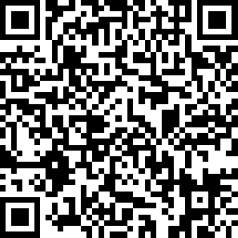
Workshop Evaluations
Link for workshop evaluations:
https://www.surveymonkey.com/r/OCCSAWK24

