Slide 1
Notes:
1-3 Ben
4-6 Andrew
7-10 Jessica
11-13 Ben
14-16 Andrew
17-25 Jessica
26-27 Ben
28-34 and 35-39 Andrew
40-46 Jessica
47-51 Ben

Slide 2
Considering Someone is High-Risk
Identifying and Responding to Crime-Producing Needs
OHIO CORRECTIONAL AND COURT SERVICES 12/5 1:45PM TO 3:15PM
Ben
Dulle
Jessica
Bradshaw
Andrew Pietras
Notes:
(Ben) Welcome to Considering Someone is High Risk: Identifying and Responding to Crime Producing Needs. I’m …. (Intro) I will be your moderator for this session.
On any given day in Ohio, we are responsible for the supervision of about 32,000 justice involved individuals. (2020). About 22% of those individuals are high or very high risk. We are here today to consider this group. As we have all learned the failures of high-risk individuals can have drastic consequences felt throughout our communities. At Ohio Parole we have invested heavily in risk assessment to try to predict who is high risk. But behind every risk score is a person. Our presenters will spend time on understanding and responding to the needs that drive the behaviors of individuals who are the most harmful.
Introductions.
Ben Suciu
Seth Howard
Andrew Pietras
Ben Suciu

Slide 3
Training Objectives
Deeper dive into the underlying characteristics that make a person high-risk.
Practice responding to high risk factors on a simulated case.
Notes:
(Ben) The risk assessment scores someone as high risk, now what? In the next hour and a half, our Ohio Parole trainers will go through the underlying characteristics that make a person high risk, taking a deeper dive into traits like aggression and risk taking. They will show you some of the tools that we are using in Ohio. We are going to practice responding to high risk factors on a simulated high-risk individual named Colin. With that I will turn things over to Andrew.

Slide 4
High risk individuals
Injury, loss, social problems
Most in need
Best chance to reduce crime, recidivism
Notes:
(Andrew) Generally speaking, when we say someone is high risk, we mean that as they go through their day there is a higher chance of injuries, loss and/or social problems.. High-risk individuals are the focus of attention and interventions for many issues such as Eating disorders, teen pregnancy and traffic accidents. When you are driving on the freeway, does it matter to you when a driver riding along next you is texting, while driving? (maybe mixed answers) What if I told you that People who text and drive are 23 times more likely to be involved in car accidents? (open) What if I told you that texting while driving is 6 times for dangerous that intoxicated driving? (open) With limited resources and time, the goal is to work with the small number of people who are most in need. A high-risk individual has behaviors and characteristics that make them more likely to have poor quality of life than the average person. In the case of texting while driving could be car accidents, possibly higher insurance rates, but also consider family and friends may not want to get in the car with them. Also consider they may not be able to work jobs that involve driving. In criminal justice we say someone is high risk because there is a higher chance of them committing crimes and recidivating. Some of the things we look at to decide if someone is high risk are unsuccessful release, prison, victim satisfaction surveys, new crimes, and technical violations. The goal is to understand what makes a person high risk and then reduce that risk. What is it that makes someone more likely to victimize, commit crimes, and end up back in the criminal justice system? We are going to look at specific factors that answer this question.
From Implementing Evidence-Based Practice in Community Corrections: The Principles of Effective Intervention SOURCE https://s3.amazonaws.com/static.nicic.gov/Library/019342.pdf

Slide 5
risk
Crime, Recidivism, Public Safety
Notes:
(Andrew) In the criminal justice system, crime, Recidivism, and public safety all fall under the idea of risk. When we talk about risk, we're talking about the threat that a supervisee poses to the safety and property of people in the community. In other words, the likelihood that they will commit another crime. Risk does not necessarily predict the seriousness of a future crime, but rather the probability that the person will reoffend. Think of risk as being on a continuum. On the high end are supervisees who are the highest risk of further criminal activity. They have many antisocial characteristics. Making sense of supervisee risk requires that we establish what we mean in criminal justice when we say antisocial. In terms of risk, antisocial means not going along with society’s norms or lacking concern for what is socially acceptable. A prosocial person is concerned about following social rules. As prosocial people, we adhere to rules and understand how they keep things orderly. We go in through the indoor and out through the outdoor. Why? Because it's what we are supposed to do! The antisocial person goes in through the outdoor, simply to be defiant or perhaps because it’s easy. There are many different factors to consider when determining the risk of a supervisee. That identification is key because the more of those factors that a supervisee has, the higher the probability that they will commit additional offenses.

Slide 6
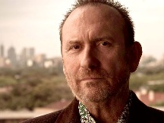
CASE ASSIGNMENT: COLIN
Colin is 23 years old. He was arrested many times as a juvenile. He spent a year in juvenile detention when he was 16. He started drinking alcohol regularly prior to the age of 17. He is an active member of the heartless felons, and all his friends are involved in criminal activities. When discussing his arrest history, he states that he finds it exciting to be chased by the police and enjoys being in risky situations. He is not involved in any structured leisure activities. He believes that judges are the real criminals. He reports that most of his time is free. He is not motivated to make positive life changes. An Risk Assessment-Supplemental Reentry tool (SRT) was completed on Colin, and he scored 23, categorizing him as high risk. He scored high/moderate in the following domains: Education/Employment/Social Support, Substance Use, Criminal Attitude and Behavior Patterns. He has been working with you but has not focused on a general goal. He just made a statement to you that he filled out a job application this morning.
Notes:
(Andrew) We’ve just been assigned a case. Let’s take about 1 minute to read through the collateral information that we have on Colin:
What stands out about Colin that makes you think that he is high risk?
(Risk Assessment score, criminal attitudes, prior history…. )

Slide 7
The Risk Principle
Match interventions to risk level
Focus on high-risk supervisees
Notes:
(Jessica) Considering that Colin is high risk, we are going to supervise him differently than someone who is not high risk. We work hard to balance our role of supervision and service provider. Not all supervisees receive the same interventions. On one end you have intense supervision, more frequent contact, and mentoring. On the other extreme, you have very limited contact and supervision. The idea behind the risk principle is to focus our most intense supervision and services on the supervisees who are most likely to reoffend. In contrast, supervisees who are least likely to reoffend should receive the least correctional interventions. The risk principle means matching up our supervision tools and monitoring strategies to be more effective at managing supervisee risk.
Resource https://info.nicic.gov/tjc/module-5-section-2-risk-need-responsivity-model-assessment-and-rehabilitation
“ Risk Management involves determining risk level of the offender and providing appropriate sanctions and supervision” Corrections in the Community Latessa & Smith 2007

Slide 8
Risk Factors
Antisocial Attitudes
PRIMARY
Antisocial Personality
Antisocial Behavior
PRIMARY
Antisocial Peers
Notes:
(Jessica) We saw in the description that Colin’s risk score is 23, making him high risk. But what makes our supervisee high risk? There are eight factors associated with risk of re-offending. The first four are considered primary factors. They are: Antisocial Attitudes, Antisocial Peers, Antisocial Personality traits and a History of Antisocial Behaviors. These four are common in our high-risk supervisee’s. Often, you work with people who have long histories of involvement in the criminal justice system and consistently get arrested. Much of that behavior is indicated by attitudes, peers, traits, and previous behaviors.
I supervised someone named Moss. From an early age he was in the system. He started smoking marijuana in junior high school and began smoking Marijuana with PCP and formaldehyde in high school. Most of his friends were from his gang, the heartless felons. He acted on impulse and aggression. He thought that if someone wronged him, then it was okay to spit in their face, which is an antisocial attitude that is likely to act on. His gang affiliations are antisocial peers, Impulsivity and Aggression are Antisocial personality traits. Using drugs at a young age are a history of antisocial behaviors.
These four risk factors are the source that other behaviors stem from. Similar to the idea that texting and driving may predict someone who is high risk of getting into car accidents, these four predict future criminal behaviors. One way to think of primary risk factors is like primary colors. Red, Yellow and Blue are a base for all other colors. So, all other colors are made from red, yellow and blue. Similarly with primary risk factors. The attitudes, peers and traits that a person has shape so many factors in their life.
Source Gendreau (1996). Offender Rehabilitation: What we know and what needs to be done. Gendreau, Little & Goggin (1996) A meta-analysis of the predictors of adult offender recidivism: What works! Criminology, 34: 575-607.

Slide 9
Risk Factors
Limited Family Support
PRIMARY
Low Levels of Accomplishments in Education or Employment
Substance Abuse
Absence of Prosocial Leisure Activities
Secondary
Notes:
(Jessica) The other four risk factors are Limited Family Support, Absence of Prosocial Leisure Activities, Limited Education/Employment success, and Substance Abuse. Consider when someone when someone is high risk, their family, leisure, substance use, and employment are often undermined by the primary risk factors. Consider how the antisocial attitudes and personality traits of someone who is high risk would create problems for them with employment. If a high risk individual thinks it is okay to steal, getting them a job is only effective if we address the underlying attitude that drives them to steal. Otherwise, we end up with a high-risk individual who thinks it is okay to steal from their employer. Therefore, as we address secondary risk factors like employment and substance use, it is also important to ensure we are addressing antisocial attitudes and traits. When addressing the secondary risk factors, of high risk focus on why things like employment and substances continue to be a problem for them. Secondary risk factors like employment or substance use form from the primary risk factors, much like mixing red and blue together gives your purple. Even though, you may see purple, what is really there is a combination or red and blue.
Source Gendreau (1996). Offender Rehabilitation: What we know and what needs to be done. Gendreau, Little & Goggin (1996) A meta-analysis of the predictors of adult offender recidivism: What works! Criminology, 34: 575-607.

Slide 10
Case Review List two risk factors from Colin’s case
Antisocial Behaviors
Antisocial Attitudes
Antisocial Peers
Antisocial Personality Traits
Limited Family Support
Absence of Prosocial Leisure Activities
Low Education/Employment accomplishments
Substance Abuse
Notes:
(Jessica) Let’s talk about Colin’s risk. What risk factors do you see?
Colin:
Antisocial Behaviors: juvenile arrest, detention, regularly drinking before 17
Antisocial Peers Gang affiliation, friends in criminal activities
Antisocial Personality Traits: Risk Taking
Leisure/Recreation: No structured activity, free time
Education/Employment: Most of his time is free (may need more info)

Slide 11
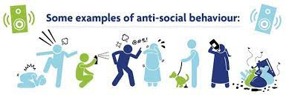
History of Antisocial Behaviors
Fighting in elementary school.
Getting suspended from high school.
Starting drinking alcohol weekly as a teenager.
Previously quit a job without having another one.
Previously arrested.
Prior convictions.
Prior sentences to correctional facilities.
Notes:
CAN SUBSTITUE REAL SITUATIONS FOR ROY AND MOSS
(Ben) By now, you have probably guessed that not all supervisees are created equal. Some are at higher risk of failing in the community than others. Let's examine the first primary risk factor: A history of Antisocial behaviors. As you look back on a person’s history, do you see the prosocial shaping that occurs? Or do you see a history of antisocial behaviors?
Let me tell you about my neighbor, Roy. He went to the same high school as me. He rarely missed a day and got a long well with his teachers. When he was in ninth grade, a few kids tried to get him to experiment with drugs, but he was involved in sports so he said no. His math teacher gave him some extra mentoring, and he decided that when he graduated he wanted to study engineering. He had quite a few friends in high school that were making college plans. While in college he was an average student. Sometimes he drank too much on weekends. He worked in restaurants part-time. He is engaged to be married.
Let’s consider Moss again. He started getting into fights when he was in junior high school. He experimented with drugs while in school. He couldn’t sit through class and was often thrown out. He drank regularly during his teenage years. He has had a few jobs, which he quit without notice, usually because he didn’t like the boss. Most people reacted badly to him. He has been in correctional facilities since a young age. He is on his third prison number, and still in his 20’s. The last time I talked to him, he told me that he was coming down to the Parole Office to spit in someone’s face.
Think about how Roy formed supportive connections with family, completed education/employment goals, and found friends and hobbies that they liked. They look back on life accomplishments such as graduations, promotions, and anniversaries.
Now, consider Moss (a high-risk person with antisocial behaviors). They may have been influenced by antisocial role models during their formative years and antisocial behaviors start to become evident at an early age. They did not have educational accomplishments, possibly getting suspended from school or dropping out altogether. When other kids were engaged in extracurricular activities, they began drinking alcohol regularly as a teenager. The pattern of antisocial behaviors continued as they tried to move into the workforce, and they go for periods without working or quit a job without a plan for another. As an adult, they failed to follow the rules and laws resulting in arrests and convictions. A history of antisocial behaviors form a foundation for what comes next and are exhibited in a variety of settings. In the same way that positive school and work experiences increased a prosocial person’s chances for personal and community successes, Criminal activities lead to community failures and sentences to correctional facilities.
Crime Control in America What Works? Worrall, 2008

Slide 12
Considering someone is..
High Risk: 60% to 40%
Low Risk: 10% to 20%
Notes:
(Ben) When we say someone is high risk, like Moss, what we are really saying is that research has shown that they have about a 60% probability of committing further crimes. So, what happens when we provide intensive supervision and services to those supervisees? Research shows that given this more intense level of service, the likelihood that a high-risk supervisee will recidivate drops to 40%.
Now let’s think about Roy. When we say someone is low risk, we are saying that someone has about a 10% chance of committing future crimes. What happens when we increase their supervision and services provided to this low-risk group? Research has shown that we actually increase the chances of them committing a new crime to about 20%. That’s right. As effective as criminal justice services may be at reducing the harm done by higher risk supervisees, the same responses can double the chances that a low-risk supervisee will commit further crimes, which is one reason why we consider if someone is high risk.
Resources: https://www.publicsafety.gc.ca/cnt/rsrcs/pblctns/2010-01-rnr/index-en.aspx

Slide 13
Case Review What Antisocial Behaviors are in Colin’s history
Arrest History
Conviction History
Prior Prison Sentence
Prior Probation
Prior Violations
Prior Prison/Jail Disciplinary action
High School Suspension/Expulsion
Employment (Fired/Quit)
Alcohol History
Drug History
Notes:
(Ben) Provide at least one antisocial behavior from your case:
Colin: Antisocial Behaviors: juvenile arrest, detention, regularly drinking before 17

Slide 14
Need Principle
Antisocial attitudes
Antisocial peers
Antisocial personality
Family
Education/employment
Leisure activities
Substance abuse
Andrews & Dowden (2006) Risk principle of case classification in correctional treatment. International Journal of Offender Therapy and Comparative Criminology. 59(1): 88-100.
Notes:
(Andrew) Prior offenses and a history of using drugs or alcohol are things that a high-risk individual cannot change. Let’s shift focus and discuss dynamic factors. The dynamic, or changeable, risk factors are the reason that a high-risk individual’s 60% probability of reoffending can be reduced to 40%. Changeable factors associated with risk are the criminogenic needs. In other words, they are areas of need that, if unaddressed, produce crime and, if addressed, reduce the probability of future crime.. Often, we focus on the wrong targets and wonder why we're not seeing a reduction in recidivism. This is what we should address with our high-risk individuals or the need principle, which indicates that criminal justice interventions should target factors that most influence criminal behaviors.
There are seven dynamic criminogenic needs:
Antisocial attitudes,
Antisocial peers,
Antisocial personality,
Family,
Education/Employment,
Leisure activities, and
Substance abuse.
Let's spend some time making sense of all seven relate to someone who is high risk.
Gendreau (1996). Offender Rehabilitation: What we know and what needs to be done

Slide 15
Criminogenic Need: Antisocial Attitudes
I didn’t hurt anybody but myself
People who go to work are suckers
I was never good as a father
I was just in the wrong place at the wrong time
Everyone steals
Judges are the real criminals
I need to (be) show (n) respect on the streets
That Law is unfair
Yeah, I did it (the crime) but...
Notes:
(Andrew) The first dynamic criminogenic need is Antisocial Attitudes. A person’s attitudes can go a long way to predict their behaviors. Our attitudes about work, rules, loyalty, and commitment impact what we will do as we navigate our day and as different situations arise.
When Roy talks, he says things like “everyone has to go to work to pay bills” and “I’m sorry, I hurt you.”
Moss frequently says “I didn’t hurt anyone but myself” or “I was just in the wrong place at the wrong time”
Why does it matter?
They are excusing their criminal behavior. High risk people often have these attitudes. These are statements that tell you that more criminal behaviors are yet to come. If you are going to change a behavior, then you have to change the attitude. It’s not easy. Avoid telling the high-risk offender to stop making antisocial statements. Really changing antisocial attitudes involves retraining the brain to think about things differently. Later in this training we’ll go over some tools and interventions that work to change these criminal attitudes of high-risk individuals.
Risk Assessment MANUAL
Retained from https://www.researchgate.net/publication/232542677_The_Measures_of_Criminal_Attitudes_and_Associates_MCAA_The_Prediction_of_General_and_Violent_Recidivism
Corrections in the Community Latessa & Smith, 2007
Retained from https://www.researchgate.net/publication/232542677_The_Measures_of_Criminal_Attitudes_and_Associates_MCAA_The_Prediction_of_General_and_Violent_Recidivism
Corrections in the Community Latessa & Smith, 2007

Slide 16
Case review What Criminal Attitude does Colin express?
I didn’t hurt anybody but myself
People who go to work are suckers
I was never good as a father
I was just in the wrong place at the wrong time
Everyone steals
Judges are the real criminals
I need to (be) show (n) respect on the streets
That Law is unfair
Yeah, I did it (the crime) but...
Notes:
(Andrew) What antisocial attitude did Colin express?
Colin: Antisocial Attitude: Judges are the real criminals

Slide 17
Criminogenic Need: Antisocial Peers
Context
“I have a heart for all my friends”
“All my friends are in the heartless felons”
Notes:
(Jessica) The second primary criminogenic need is unsurprisingly antisocial peers. Think about how the people that a person spends time with provide context for their lives. Friends can be role models who reinforce what they do.
Roy has several friends from work and school. He plays on a baseball team in the summer. A few of the seasoned employees at his job have been training him.
Now consider Moss who is spending time with people involved in gang activity. He doesn’t know anyone who currently works.
Think about how those people may impact the situations they find themselves in and the choices that they will make. How much more would the impact be if more than half of their friends were involved in criminal activities? Much like you may seek out like minded people who are similar to you, a high-risk individual often seeks others who are engaged in antisocial criminal behaviors.
Corrections in the Community Latessa & Smith, 2007

Slide 18
Criminogenic Need: Antisocial Personality Traits
Lack of empathy/concern for others
Poor coping skills
A taste for risk
Restlessness/aggressive energy
Weak problem-solving skills
Poor self-control/impulsivity
Notes:
(Jessica) The third primary criminogenic need is Antisocial Personality traits. High risk individuals often have some traits that lead to criminal behavior. Thinking about your high-risk individuals do you see traits like: Lack of empathy, poor coping skills, risk seeking, aggression, poor problem solving and being impulsive. It’s important to identify these traits. You may recognize some from Risk Assessment assessments. These drivers of criminal behavior are excellent targets for change. Successful officers practice paying attention to what people say and do, to recognize the underlying personality traits they may be exhibiting. Let's talk more about these…
Retrieved from https://liveboldandbloom.com/02/self-awareness/list-of-personality-traits
https://www.researchgate.net/publication/312642673_Pathological_personality_traits_and_criminogenic_thinking_styles

Slide 19
Antisocial Personality Traits: Lack of Empathy
Unable to express concern for family and friends.
Unable to express concern for others.
Limited communication ability.
Notes:
(Jessica) What is empathy? Empathy is the trait of experiencing and understanding the feelings of other people. An empathetic person is not as likely to harm or take advantage of other people because they understand how that would feel. Lack of empathy is an antisocial personality trait and an important criminogenic need to identify. But it goes beyond that. A person who is able to communicate empathy towards others is more likely to be successful socially. An empathetic person is not only a better communicator, but better at reading verbal cues. Think about how others react to someone who shares in their experiences. Consider how a high-risk individual who lacks empathy will fail at forming relationships in school and work. A good goal when working with someone who lacks empathy is to practice basic empathetic social skills like listening or understanding the feelings of others. We will talk about social skills later.
Retrieved from https://liveboldandbloom.com/02/self-awareness/list-of-personality-traits
https://www.researchgate.net/publication/312642673_Pathological_personality_traits_and_criminogenic_thinking_styles
https://goals.com/5-benefits-of-empathy-and-how-to-be-more-empathetic#:~:text=%205%20Benefits%20of%20Empathy%20%28and%20How%20to,relief%20and%20enhanced%20communication%20skills%20are...%20More%20

Slide 20
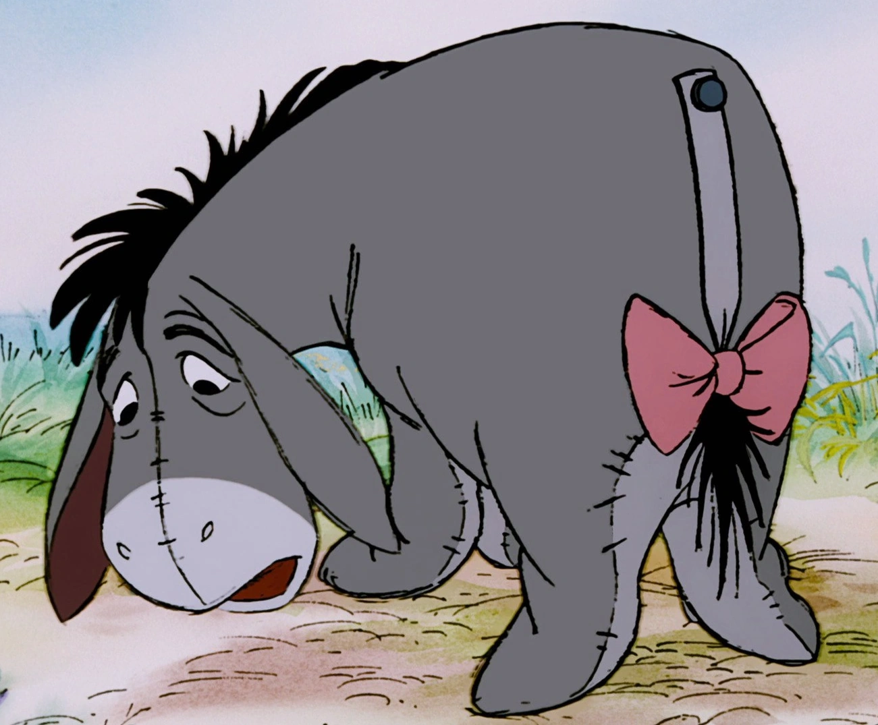
Antisocial Personality Traits: Poor Coping Skills
Lacks control of day-to-day activities
Notes:
(Jessica) Consider someone who is high risk and how they deal with life stressors. They often feel like they cannot cope with day-to-day activities. Poor coping skills become an antisocial personality trait when a person who is faced with life stressors struggles to maintain control over situations and believes criminal actions are a good option. At the extreme, they feel they have no control over their lives. A good strategy to employ with people trying to change this trait is to help them develop healthy, prosocial coping skills over time.
OPTIONAL VIDEO OF EEYOR:
https://www.google.com/search?q=EEYOR+TRYING+ON+NEW+TAILS&rlz=1C1GCEB_enUS960US960&oq=EEYOR+TRYING+ON+NEW+TAILS&gs_lcrp=EgZjaHJvbWUyBggAEEUYOdIBCDcwODRqMGo3qAIIsAIB&sourceid=chrome&ie=UTF-8#fpstate=ive&vld=cid:b72849af,vid:4chZa7N7vGo,st:0
Retrieved from https://liveboldandbloom.com/02/self-awareness/list-of-personality-traits
https://www.researchgate.net/publication/312642673_Pathological_personality_traits_and_criminogenic_thinking_styles

Slide 21
Antisocial Personality Traits: Risk-taking
Exciting to get into dangerous situations.
Routinely place themselves in harm's way.
Risk across situations.
Notes:
(Jessica) We all take some risks. Most people would exercise some degree of caution when they are faced with a dangerous or risky situation. On the other hand, high risk individuals often find it exciting to get involved in dangerous situations. They routinely place themselves in harm’s way to reach a goal or get what they want. This antisocial personality trait is characterized by people who invest time and energy in criminal activities simply for the thrill. They pursue trouble and are quick to put themselves at risk in different settings.
Retrieved from https://liveboldandbloom.com/02/self-awareness/list-of-personality-traits
https://www.researchgate.net/publication/312642673_Pathological_personality_traits_and_criminogenic_thinking_styles

Slide 22
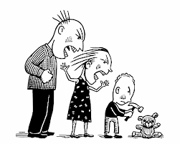
Antisocial Personality Traits: Aggression
Use hostility to get what they want.
Doesn’t walk away from a fight.
Does not need to be provoked to lash out.
Notes:
(Jessica) A prosocial person finds acceptable methods to get what they want in life, which is in direct contrast to a higher risk person with an aggressive personality trait.
Consider some things that an aggressive person may do. Use threats or hostile behavior to get what they want. Aggressive people will not walk away from a fight. They do not need to be provoked to lash out or become violent. They often get in trouble for fighting and experience limited success in life due to calloused and manipulative actions that are received poorly by others. Think about some of your Risk Assessment items that look at fighting, anger, past crimes and prison write ups. Also consider Risk Assessment items that look at family and education. Does aggression contribute to your case’s higher risk score?
Retrieved from https://liveboldandbloom.com/02/self-awareness/list-of-personality-traits
https://www.researchgate.net/publication/312642673_Pathological_personality_traits_and_criminogenic_thinking_styles

Slide 23
Antisocial Personality Traits: Weak Problem Solving
Life stressors are overwhelming.
Believe they cannot overcome the past.
Difficulty seeing a wide variety of options.
Criminal behaviors seem like the only option.
Notes:
(Jessica) When someone fails to develop the skills necessary to manage life stressors, it becomes another criminogenic personality trait. You see this with high-risk supervisees when they experience stressful situations in the community. Then, not surprisingly, problems arise, and they view criminal activities seem like the only solution to their problem. As you think about the high-risk cases that you work with, consider are they able to look at different options, weigh consequences and then come up with a solution. If not, how successful will your high-risk person be in the community. Think about this: If a high-risk person sees criminal activities as the best solution to a problem, then how successful will they be with work or family? The best way to address poor problem-solving skills is by practicing problem solving strategies where a number of options are considered, and the potential consequences of each option are weighed. We’ll look at a problem-solving tool that we use later.
Retrieved from https://liveboldandbloom.com/02/self-awareness/list-of-personality-traits
https://www.researchgate.net/publication/312642673_Pathological_personality_traits_and_criminogenic_thinking_styles
CONSIDER COMBINING WITH PROBLEM SOLVING FOR STAFF (OPTIONAL)

Slide 24
Antisocial Personality Traits: Poor Self-control
Impulsivity
Does not plan events.
Acts without considering consequences.
Notes:
(Jessica) There are many social rules regarding how to engage with others. Prosocial individuals will attempt to exercise control over what they say and do to act in a manner appropriate for a given situation. High-risk individuals are more impulsive, often speaking or acting without thinking. For those that we supervise, it becomes a criminogenic need when a person’s life is characterized by impulsivity and an inability to plan events. This is the person who cannot consider how their actions lead to consequences. The goal when working with people with poor self-control is to get them to practice slowing down... to practice thinking before they act.
Retrieved from https://liveboldandbloom.com/02/self-awareness/list-of-personality-traits
https://www.researchgate.net/publication/312642673_Pathological_personality_traits_and_criminogenic_thinking_styles

Slide 25
Case Review What Antisocial Personality Trait does Colin have?
Lack of Empathy
Poor Coping Skills
Risk Taking
Aggression
Weak Problem Solving
Poor Self Control/Impulsive
Notes:
(Jessica) What Antisocial Personality Traits does Colin have?
Colin: Antisocial Personality Traits: Risk Taking
(Note: other traits may also apply, but the case absolutely has this trait)

Slide 26
Secondary Criminogenic Needs
Family
Education/Employment
Leisure/Recreation
Substance Abuse
Notes:
(Ben) Unsatisfactory family support may range from low levels of affection, caring, and cohesiveness to outright neglect or abuse. When making sense of family as a criminogenic need, consider the roots of the problem. A person with a calm demeanor who does not believe that you should hurt other people may not act violently because someone is disagreeable. However, an aggressive person who thinks that you must get people before they get you may exhibit violence in the family when someone disagrees with them. The same antisocial personality trait that drives a high-risk supervisee to commit crimes has also created an unsatisfactory family relationship, making the overall chances for their success even worse.
Consider a motivated person at a very early age who is taking responsibility and practicing the habits that will help them to be successful in school. Building on small successes leads to bigger successes. The attitudes and traits that drive their success are deeply rooted, as indicated by their work ethic. Now let’s consider an alternative path. An unmotivated person acted up in school and did not achieve early success. Failing to find the rewards that come with these successes, they turned in a different direction. They started to accumulate antisocial behaviors, such as getting suspended from school, failing to graduate, or getting fired from jobs. Maybe they found getting into trouble or substance use to be more rewarding. Also, because of limited accomplishments in education and employment, they were not interacting with other students, coworkers, and learning to respect people in positions of authority. As important as it is to address education/employment goals with supervisees, it is understandable that their education/employment needs are bigger than just finding a job or getting a GED. Consider the supervisee who lacks the coping skills to manage day to day events. Their response to work stressors or loss of a job will be very different than the average employee. When the average person loses a job, they rely on family support and start applying for new jobs. This is how they learned to be successful in the past. A high-risk supervisee without the same ability to cope may respond very differently and could end up resorting to criminal activities to try and earn money quickly. Practicing problem solving skills and coping skills can be very beneficial for a supervisee trying to make it in the workplace.
The last two secondary criminogenic needs go together. A person with underlying antisocial attitudes and traits, may chose substances over typical leisure activities.
This is the best way to make sense of what it means to be high-risk. We all know someone who may have poor family relations but does not commit crimes. Similarly, if one of us lost our job, we probably would go look for another job, instead of going out and robbing people. Also, there are many people with substance abuse issues that are not in the criminal justice system. Because high-risk offenders have the four secondary needs on the screen, but more importantly they have the primary risk factors of antisocial attitudes, traits and peers. Which is why success with high risk means addressing the primary needs too.

Slide 27
Case Review What secondary criminogenic need does Colin have?
Limited Family Support.
Absence of Prosocial Leisure Activities.
Low Education/Employment accomplishments.
Substance Abuse.
Notes:
(Ben) To be effective we want to focus on the dynamic criminogenic needs: Antisocial attitudes, Antisocial peers, Antisocial personality, Family, Education/Employment, Leisure activities, and Substance abuse. What secondary criminogenic needs does your case have?
Colin:
Leisure/Recreation: No structured activity, free time.
Education/Employment: Most of his time is free. (may need more info)
Think about Colin for a minute, what would happen if he got a job and we don’t address his criminal attitudes or criminal risk-taking behavior. He is now in the work place ready to get in trouble and thinking it’s okay to get in trouble. How important is it to address the attitudes, traits and peers that drive Colin’s criminal behaviors? (very)

Slide 28
High Risk Interventions
Ohio Risk Assessment System: High or low risk, criminogenic need.
Responsivity: Barriers to change.
Case planning: goals and objectives.
Cognitive behavioral programs/interventions
Core correctional practices
Carey guides
Internal change: Motivational interviewing
Notes:
(Andrew) Consider that if someone is high risk, we want to have more contacts that address the criminogenic needs. The goal is to spend the majority of our time (unconsciously up to 80% of time) addressing these needs. What you see are some of the high-risk interventions that we use to get there.

Slide 29
Cognitive Behavioral Programs
High Risk Situation
Keep Practicing
Notes:
(Andrew) Cognitive Behavioral programs are the most effective programs at reducing criminal behaviors of high-risk offenders. To understand the process that your high-risk individual goes through in a Cognitive Behavioral Group, the first thing to keep in mind at every point it will come down to thinking controls behavior. A typical group begins with the facilitator teaching a new skill. The facilitator then models the new skill to show supervisees how to do it correctly. Then participants identify high risk situations. These are the times, places and people that get them into trouble. Once they have a risky situation, then they practice in group as if they were in the situation or roll play. Roll play, or practicing prosocial behaviors is key. They get feedback and continue to practice in group or out of group through assigned homework. Each group will build on what is learned before. When we have a high-risk individual in a Cognitive Behavioral group, keep encouraging them to bring their risk situations to the group. Ask them if they are practicing and doing their homework. The goal is to keep supporting them on changing the thinking that leads to their criminal behaviors. We want to encourage them to keep practicing out of group until the new skills become natural for them.

Slide 30
Cognitive Behavioral Programs
Thinking For A Change
Decision Points
Anger Control
Notes:
(Andrew) If you know what is going on in Cognitive Behavioral programs, then you can support those changes. These are some of the Cognitive Behavioral Groups we use to address a high-risk individual’s antisocial attitudes and traits. On the slide are three of the Cognitive Behavioral Programs that we use.

Slide 31
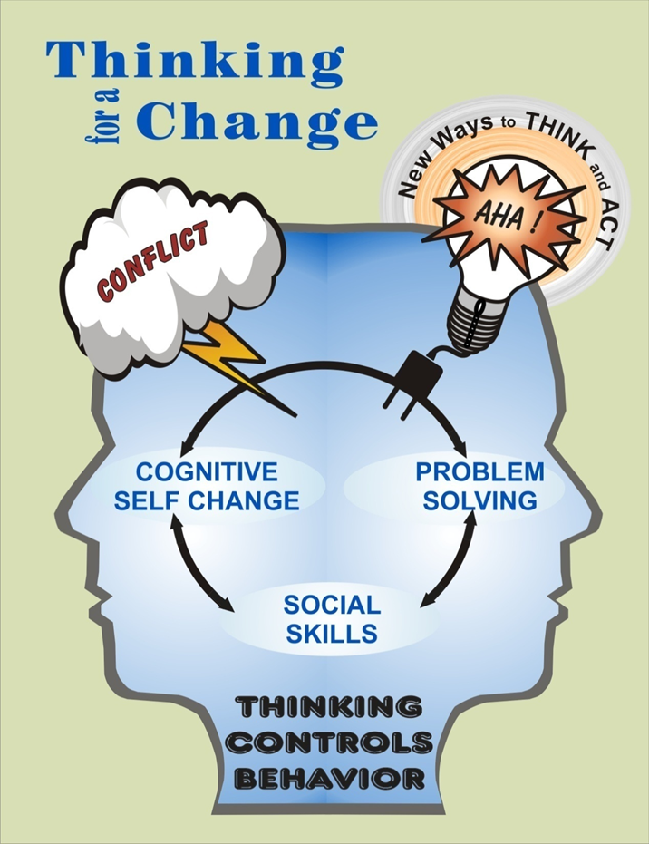
Notes:
(Andrew) Thinking For A Change has 25 sessions. A high-risk individual in T4C will go through the lessons in order. T4C has three main components: Social Skills, Cognitive Self Change, and Problem Solving. Each lesson builds on the one before it. A supervisee in T4C will learn a broad range of prosocial/anticriminal thinking, and responses. Participants practice the new skills in group and are assigned homework to use the new skill in a real-life risk situation. If you have a high-risk person in T4C, you can use the wording that they use to assist with getting the supervisee to make changes.

Slide 32
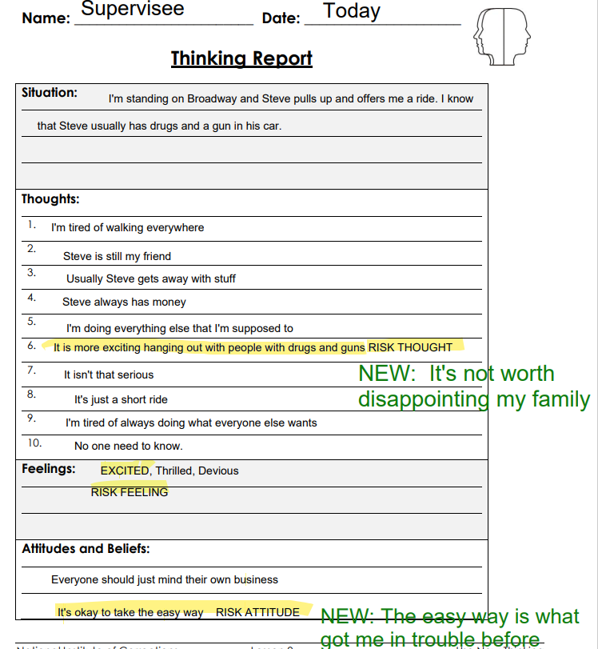
Notes:
(Andrew) As an important part of T4C, a high-risk individual will learn and practice thinking reports. This is the Cognitive Self Change part. You can see the person identifies the risk situation, lists thoughts that may lead them to hurt someone or break a law. Lists the feelings that go with those thoughts, then the underlying attitudes and beliefs. T4C facilitators will then work with your supervisee on replacing those thoughts and behaviors that keep getting them into trouble. We’ll talk about Problem Solving and Social Skills shortly.

Slide 33
Show Support
Discuss risk situations
Discuss out of group practice
Discuss the group participation
Supervisee, Facilitator and Parole Officer meeting
Notes:
(Andrew) When you have a high-risk individual in group, the role of the officer is to be supportive. You can show support by discussing risk situations that they put themselves in. Tell them to use the situation on their next homework assignment or group role play. All groups assign homework, this is so the supervisee can practice new thinking in real life situations. Talk to your high-risk individual about their homework and if they are practicing what they learn in group when they are with family friends or in high-risk situations. All groups require supervisees to practice, have conversations with your them about practicing the situations that lead them to brake rules or hurt people while they are still in group. If your supervisee is struggling, consider meeting with them and the facilitator. It is a way to show that you all three want the high-risk individual to be successful and stay out of trouble. After completing the group, keep reminding the supervisee to practice what they learned in real world situations. These are the situations where they get in trouble, the group teaches alternative thinking and behaviors to get out of trouble. They can keep using the thinking report after the group ends.

Slide 34
Case Review
Would you refer your case to a cognitive behavioral program?
Why/Why not?
If yes, which program?
How would you support your supervisee while in the program?
Notes:
(Andrew)
Would you refer Colin to a cognitive behavioral program? Yes
Why? To address Criminogenic Needs, Attitudes lead to criminal behaviors… Any EBP answer acceptable
If yes, which program? T4C, Decision Points, or Anger Control
If yes, which case plan domain does it address?
Colin:
Criminal Attitudes and Behavior Patterns.
5. How would you support your supervisee while in the program?
Discuss risk situations
Discuss homework
Discuss participation and attendance
Meet with supervisee and facilitator together
Assign tools after group

Slide 35
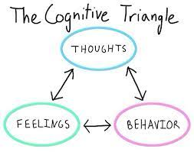
Examples: Individual Interventions
Field/Office Interventions
Cost-Benefit Analysis
Behavior Chain
Problem Solving
Carey Guides
Notes:
(Andrew) Some high-risk individuals may not be able to attend a group or may not need an intensive group. There are also individual Cognitive Behavioral interventions that we use in Ohio Parole. These can be done one on one, at home or wherever you see them. The first three are our Core Correctional Practices, which is its own training.
The Carey Guides are a collection of 33 handbooks with worksheets to assist parole officers to utilize EBP with their supervisees. We’ll talk more about them in a little bit.

Slide 36
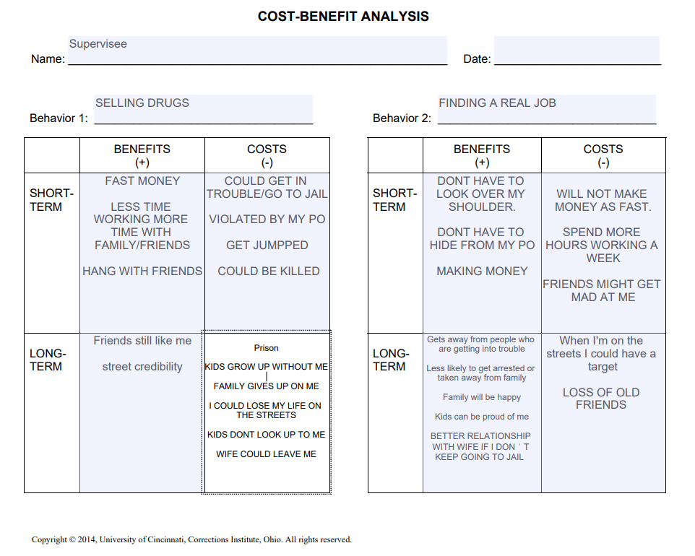
Notes:
(Andrew) (REVIEW FOR TIME) Cost/Benefit Analysis looks at positive and negative, short term and long-term consequences of an antisocial and prosocial behavior and is best with unmotivated supervisees. On the left is the supervisee’s antisocial behavior, flashing gang signs. There are a lot of short-term benefits, but long-term consequences. Which is typical for antisocial behaviors. On the right side is a prosocial alternative, just say hello. There are usually more long-term benefits to the prosocial behaviors. A logical conclusion of the cost benefit analysis is that the antisocial behavior gets me in trouble in the long term. The prosocial alternative may not feel good, but ultimately will pay off. This is good for high risk who are unmotivated.

Slide 37
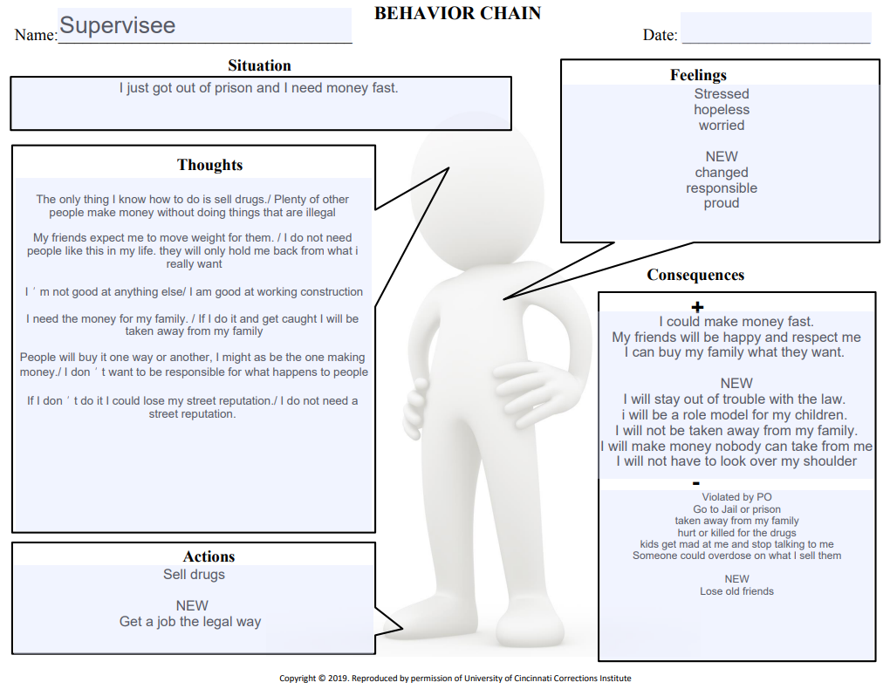
Notes:
(Andrew) The Behavior Chain looks at the antisocial thoughts, feelings and beliefs that lead to a specific behavior, then has the supervisee find replacement thoughts and beliefs that go with a new behavior. It is best with Supervisees who have antisocial thoughts. You can see the supervisee starts with a risk situation. Lists thoughts and feelings then an action. Starts with old thoughts and feelings then looks at new thoughts and feelings. How does each action get different consequences.

Slide 38
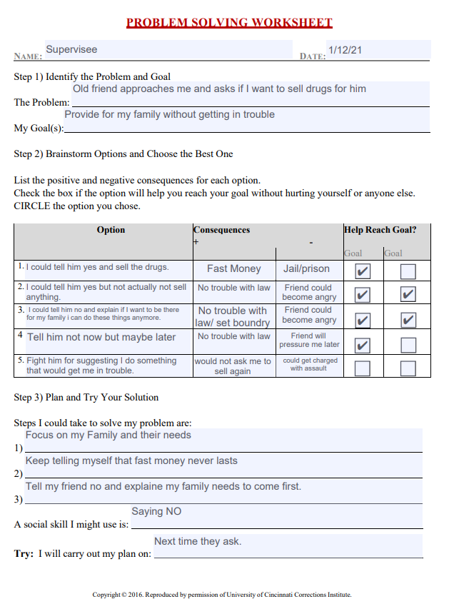
Notes:
(Andrew) Problem Solving is a tool that a supervisee uses to solve complex community problems. It is best with a supervisee who does not have a lot of antisocial thinking but cannot cope with basic life stressors such as child raising or work stress. Here is one where a supervisee has to work with a codefendant who is still getting into trouble. He sets a goal to have as little contact as possible. He brainstorms different options, decides which option gets him closest to his goal, then puts a plan into action.

Slide 39
Case Review
Which CCP tool would you use with your Supervisee?
Cost/Benefit Analysis
Behavior Chain
Problem Solving
Why did you select your tool?
Lacks Motivation
Antisocial Thinking
Complicated Problem
Poor Social Skills
Notes:
(Andrew)
Which CCP tool would you use with Collin?
Why did you select your tool?
Colin:
Cost Benefit Analysis
Lacks motivation

Slide 40
Carey Guides
Notes:
(Jessica) The Carey Guides are a collection of 33 handbooks with worksheets. Tools are designed for use by the supervisee, with assistance by their officer, to understand and address risk factors, triggers, and other conditions that are essential to their success.
Blue Guides- specifically address supervisees’ criminogenic needs
Red Guides- address common case management issues
Each guide contains 2-5 tools (worksheets)
The same Carey Guide OR section of a Carey Guide may be completed repeatedly by the same supervisee, until they are able to complete in real time.

Slide 41
Case Review Which Carey Guide would you use at your next contact?
Anger…manage their anger in a more appropriate, less harmful way.
Antisocial Associates…recognize/change or end relationships that are harmful to them.
Antisocial Thinking…understand their thinking patterns, feelings, beliefs, and values.
Empathy…increase their understanding of other people’s viewpoints.
Engaging Prosocial Others…build more friendships with people who will impact their lives in positive.
Overcoming Family Challenges…identify challenging patterns in their families and learn
Problem Solving…make sound, reasoned decisions that minimize harm to themselves and others.
Prosocial Leisure Activities…discover positive, prosocial outlets and recreational activities.
Substance Abuse…understand their patterns of substance use, the factors that influence their use, and strategies for not using.
Notes:
(Jessica)
Which Carey Guide should you use at your next contact? (any Carey Guide acceptable)
What Criminogenic need does the Carey Guide address?
The following are best answers/recommended but any Carey Guide is acceptable.
Colin:
Antisocial Thinking
Antisocial Associates

Slide 42
Evidence Based Practices
Effective Interactions
Notes:
(Jessica) TRANSITIONAL SLIDE: Let’s talk about some effective interactions to use with higher risk offenders….

Slide 43
Motivational Interviewing Spirit
Partnership
MI
“Spirit”
Compassion
Acceptance
Empowerment
Notes:
(Jessica) Motivational Interviewing is a conversation style to facilitate change. Good MI skills come overtime with a lot of practice. It is not appropriate for all situations. It is best used with high-risk individuals when you are having a conversations about why they should or should not change. That may sound counterintuitive but ambivalence about change is important. A high-risk individual has reasons that they continue in their high-risk criminal lifestyle. In fact, the information they have about why they continue in crime, is vital if they are ever going to change. Motivational Interviewing works best when a high-risk person is able to be in the driver’s seat for their own change process. We act as advisors in the spirit of partnership, compassion, acceptance and empowerment. MI involves transferring responsibility to the high-risk person for their own change process. Open Questions, Affirmations, Reflections and Summaries are the core skills to use during motivational interviewing.

Slide 44
Build a Professional Relationship
Effective Reinforcement
Effective Use of Authority
Effective Disapproval
Notes:
(Jessica) High risk individuals are not here voluntarily. It is often challenging; we must work towards building a collaborative working relationship. We emphasize accountability and mutual respect. Good communication is essential. This involves actively listening. Set appropriate boundaries. Why is it important to build a professional relationship with the people that we supervise? They are more likely to be respectful, work with us, write less grievances…
We always show our professionalism, whether working to help the Supervisee or arresting them. Emphasize to supervisees that we are in the business of getting them to make positive life changes. Some interactions that you can use in the field or office to respond to statements are effective reinforcement, effective use of authority and effective disapproval.
1.. Effective Reinforcement means that we want people to repeat prosocial behaviors. Think about how much safer it is when we get supervisees to repeat prosocial behaviors. To do this we use reinforcement or rewards. Don’t become so focused on what a supervisee is doing wrong that we forget to reinforce what they are doing right. If right-doing is not reinforced, then the person is more likely to stop doing it.
2. As Parole Officers we need to use our authority when a supervisee is about to engage in an antisocial behavior. We can talk about choices and consequences with a supervisee in a non-confrontational manner. When we get on a power trip, supervisees are more likely to feel challenged and get into power struggles with us. We want to be firm, but fair in out approach.
3. If they have already engaged in violation or antisocial behavior, we show effective disapproval. Part of being a Parole Officer is reducing the antisocial behaviors that we see with our Supervisees. If we ignore misconduct, it increases the chances that someone will do it again.

Slide 45
REWARDS
Verbal praise
Bus passes
Hygiene
Clothing voucher
Furniture voucher
Tell family member about success
Certificate
Sticker “Good Job”
Travel Permit
Skip next visit
Reduced Community Service
See in the field, instead of office
Reduced telephone reporting
Fee waiver
Early release from supervision
Notes:
(Jessica) During contacts it is as important to recognize when a supervisee engages in prosocial behavior as when they engage in antisocial behavior. We want to reinforce or strengthen that behavior with some kind of reward. What are some rewards that you can use as Parole Officers?
(CLICK,) (CLICK) These are some rewards that our agency uses. Consider a lot of what makes a person high-risk involves the thrill of risk, being impulsive and doing what feels good now, and avoiding the difficulties that come with problem solving. Rewards are especially meaningful to a group that is going to do something if it feels good.

Slide 46
Case Review
Pick one key strategy to use with your case to build a professional rapport and explain why.
Effective Disapproval
Effective Use of Authority
Effective Reinforcement
List a reward that you think would work with your case?
Notes:
(Jessica) Thinking about the last statement that Colin just made, which strategy to build a professional rapport would be most effective at this time?
Effective Disapproval, Effective Use of Authority or Effective Reinforcement and Why?
Colin:
Effective reinforcement (engaged in a behavior that was prosocial and should be repeated)
List a reward that you think would work with your case? (any are correct)
Verbal praise
Bus passes
Tell family member about success
Certificate
Travel Permit

Slide 47
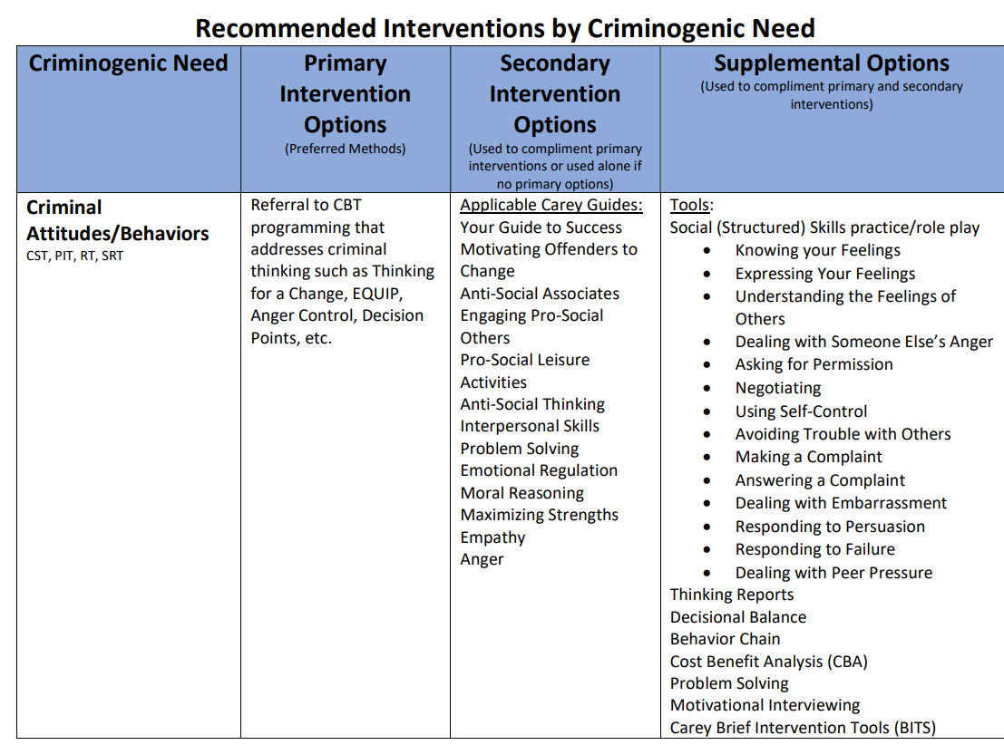
Notes:
(Ben) (HANDOUT) We have an example of recommendations by criminogenic needs. This is what we use at Ohio Parole. There is a handout that is also available in the app that has recommended interventions by Criminogenic needs. It will give you some ideas of interventions and tools that you can use.

Slide 48
CONSIDERING SOMEONE IS High Risk
Risk/Need Assessment
High Risk or Low Risk
Criminogenic Need
Cognitive Behavioral Programs/Interventions
Thinking for a Change, Decision Points
Core Correctional Practices
Carey Guides
Notes:
(Ben) Risk/Need Assessment determines someone’s potential from criminal activity and the crime producing or criminogenic needs that they have. It is a guide for how to best manage the case.
(CLICK) Cognitive Behavioral Programs and Interventions are how we address the underlying criminality of high-risk individuals.
The best responses for high-risk individuals include groups such as Thinking for a Change and Decision Points; Core Correctional Practices and Carey Guides which provide opportunities for individual interventions to address criminogenic needs, with the ultimate goal to reduce crime and recidivism.

Slide 49
Notes:
(Ben) Thank you. As you can see, we have invested heavily to increase the success of those at the highest risk of failure at Ohio Parole. With our trainers here are there any questions. (or we can stay for a few minutes if there are any questions)

Slide 50
Considering Someone is High-Risk: Identifying and Responding to the Crime-Producing Needs of High-Risk Offenders
Contact Information:
Benjamin.Dulle@drc.ohio.gov
Jessica.Bradshaw@ drc.ohio.gov
Andrew.Pietras@drc.ohio.gov
Link for workshop evaluations: https://www.surveymonkey.com/r/OCCSAWK24
QR code for workshops
Notes:
(Ben) Here are out contact emails. There is also a link and QR code for workshop evaluations.

